Slide 1

Data Preprocessing
Transforming Raw Data into Quality Insights
Unit 1: Data Mining and Analytics • CSE-355T

Slide 2
The Foundation of Knowledge Discovery
Understanding why cleaning and preparing data is the most critical step in the entire machine learning pipeline.

Slide 3



What is Data Preprocessing?
Definition
The essential process of cleaning, transforming, and organizing raw, "messy" data into a high-quality, usable format for mining.
The Golden Rule:
"Garbage In → Garbage Out"

Slide 4






Why Preprocessing is Critical
Quality
Performance
Accuracy
Real-world data is inherently incomplete, inconsistent, and contains errors or outliers.
Clean data reduces computational overhead and allows algorithms to converge faster.
Reliable models require reliable inputs. Small errors at the start lead to large errors at the finish.

Slide 5
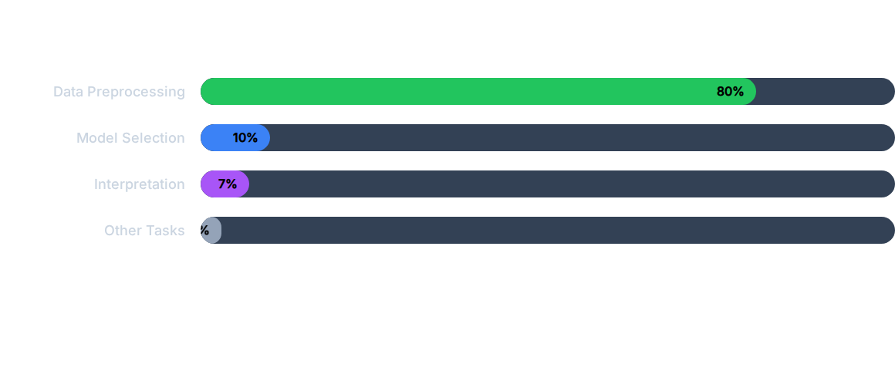
Data Science Time Allocation
Industry surveys consistently show that the majority of a data project's lifecycle is spent on preparation.

Slide 6




Task 1: Data Cleaning
Missing Values
Noisy Data
• Ignore the tuple (row)
• Binning (Smoothing by means)
• Fill manually (tedious)
• Regression (Fitting curves)
• Fill with Mean or Median
• Outlier Analysis (Clustering)

Slide 7

Task 2: Data Integration
Merging data from multiple sources (Databases, Spreadsheets, APIs) into a consistent data store.
Key Issues:
Entity Identification: Matching "Cust_ID" to "Account_No".
Redundancy: Finding duplicate attributes using correlation analysis.
Data Conflicts: Resolving different units (Metric vs. Imperial).

Slide 8



Task 3: Data Transformation
Normalization
Scaling attributes to fall within a small, specific range like 0 to 1.
Discretization
Replacing raw numeric values with interval labels or conceptual levels.
Z-Score Formula:
Example:
Age: 0-100 → {Child, Teen, Adult, Senior}

Slide 9
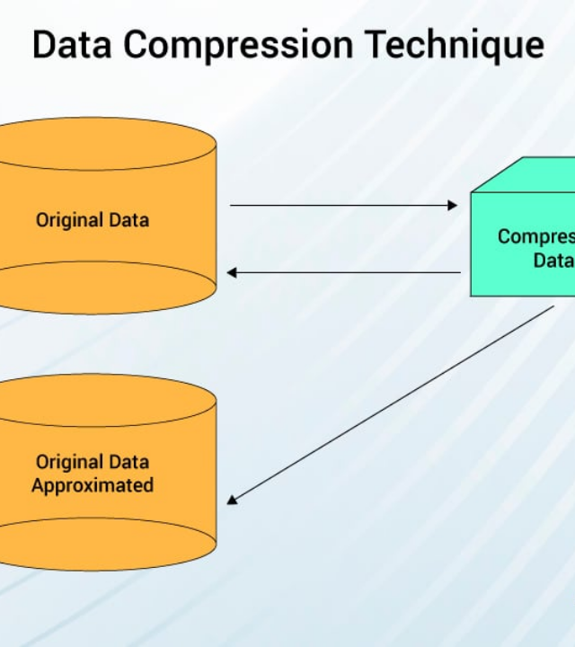
Task 4: Data Reduction
Reducing the volume of data while producing the same (or nearly the same) analytical results.
Main Strategies:
Dimensionality: Removing redundant features (e.g., PCA).
Numerosity: Replacing data with smaller models or samples.
Compression: Encoding techniques (Lossy/Lossless).

Slide 10
Summary Comparison
Process | Primary Goal | Key Technique
Cleaning | Fixing errors and missing values | Binning, Mean Filling
Integration | Merging heterogeneous sources | Correlation Analysis
Transformation | Normalizing and scaling | Min-Max Scaling
Reduction | Shrinking dataset size | Sampling, PCA

Slide 11

Conclusion
"Data preprocessing is not just a preliminary step; it is the most critical part of the data mining process. Clean data is the foundation of great insights."

